Slide 1
Principles of Programming Languages
Mutable Data
Notes:
TODO: add dictionaries instead of dispatch

Slide 2
Do you remember???
Which type did we implement last week?
Which ADT does it belong to?
What is its API?
Is it mutable? Why??
Which type did we use for its implementation?
Which types also can be used?
Which property do these types must have?

Slide 3
Mutable Data
Powerful technique for creating modular programs is to introduce new kinds of data that may change state over time
A single data object can represent something that evolves independently of the rest of the program
Adding state to data is an essential ingredient of the object-oriented programming
Notes:
we need strategies to help us structure large systems so that they will be modular, that is, so that they can be divided “naturally” into coherent parts that can be separately developed and maintained.

Slide 4
Immutable vs. mutable data
The native data types we have introduced so far – numbers, Booleans, tuples, ranges, and strings – are immutable
names may change bindings to different values in the environment, but the values themselves do not change
Mutable objects can change throughout the execution of a program

Slide 5
Tuples vs. Lists
>>> x = (1,2)
>>> y = x
>>> y is x
True
>>> y = y + (3,4)
>>> y
(1, 2, 3, 4)
>>> x
(1, 2)
>>> x = [1,2]
>>> y = x
>>> y is x
True
>>> y = y + [3,4]
>>> y
[1, 2, 3, 4]
>>> x
[1, 2]

Slide 6
Tuples vs. Lists
>>> x = (1 ,2)
>>> y = x
>>> y is x
True
>>> y[0] = 0
…
TypeError: 'tuple' object does not support item assignment
>>> x = [1,2]
>>> y = x
>>> y is x
True
>>> y[0] = 0
>>> y
[0, 2]
>>> x
[0, 2]

Slide 7
Local State
Example: withdrawing money from a bank account
We begin with $100 in the account:
>>> withdraw(25)
75
>>> withdraw(25)
50
>>> withdraw(60)
’Insufficient funds’
>>> withdraw(15)
35
Same calls, different results

Slide 8
Creating account with a balance
The function make_account is a higher-order function that takes a starting balance as an argument
The function withdraw is its return value
>>> withdraw = make_account(100)

Slide 9
Let’s try…
>>> def make_account(balance):
"""Return a withdraw function that draws
down balance with each call."""
def withdraw(amount):
if amount > balance:
return 'Insufficient funds'
return balance - amount
return withdraw

Slide 10
Second try…
>>> def make_account(balance):
"""Return a withdraw function that draws down balance with each call."""
def withdraw(amount):
if amount > balance:
return ’Insufficient funds’
balance = balance - amount # ???
return balance
return withdraw
Notes:
UnboundLocalError: local variable 'balance' referenced before assignment

Slide 11
Creating account
An implementation of make_account requires a nonlocal statement.
When we call make_account, we bind the name balance to the initial amount.
We then define and return a local function, withdraw, which updates and returns the value of balance when called.

Slide 12
>>> def make_account(balance):
"""Return a withdraw function that draws down balance with each call."""
def withdraw(amount):
nonlocal balance # Declare the name "balance" nonlocal
if amount > balance:
return ’Insufficient funds’
balance = balance - amount # Re-bind the existing balance name
return balance
return withdraw

Slide 13
Nonlocal statement
Whenever we change the binding of the name balance, the binding is changed in the first frame in which balance is already bound
Indicates that the name appears somewhere in the environment other than the first (local) frame or the last (global) frame.
Notes:
Recall that without the nonlocal statement, an assignment statement would always bind a name in the first frame of the environment.

Slide 14
Important note
Nonlocal statement does not exist in Python 2
How it can be replaced?
Soon… in the end of this lesson

Slide 15
Visualization with environment diagrams
>>> wd = make_account(20)
>>> wd(5)
15
>>> wd(3)
12

Slide 16
The Benefits of Non-Local Assignment
Maintains some state that is local to a function, but evolves over successive calls to that function
The balance associated with a particular withdraw function is shared among all calls to that function.
However, the binding for balance associated with an instance of withdraw is inaccessible to the rest of the program.

Slide 17

Environment Model
Only withdraw is associated with the frame for make_account in which it was defined.
If make_account is called again, then it will create a separate frame with a separate binding for balance.

Slide 18
Example
A second call to make_account returns a second withdraw function that is associated with yet another environment = another bank account
>>> wd2 = make_account(10)
>>> wd2(6)
4

Slide 19
Diagrams
>>> wd2 = make_account(10)
>>> wd2(6)
4

Slide 20
The Effect of Non-Local Assignment
When two names wd and wd2 are both bound to a withdraw function,
it does matter whether they are bound to the same function or
different instances of that function.
>>> wd = make_account(12)
>>> wd2 = wd
>>> wd2(1)
11
>>> wd(1)
10
>>> wd = make_account(12)
>>> wd2 = make_account(12)
>>> wd2(1)
11
>>> wd(1)
11

Slide 21
Environment Model

Slide 22
Key note
Only function calls can introduce new frames!
Non-local assignment statements always change bindings in existing frames.
In our case, unless make_account is called twice, there can be only one binding for balance.

Slide 23
Lists
Python’s most useful and flexible sequence type.
Is similar to a tuple, but it is mutable.
Method calls and assignment statements can change the contents of a list.

Slide 24
Example: playing cards
Were invented in China, perhaps around the 9th century. An early deck had three suits, which corresponded to denominations of money:
>>> chinese_suits = [’coin’, ’string’, ’myriad’] # A list literal
>>> suits = chinese_suits # Two names refer to the same list

Slide 25
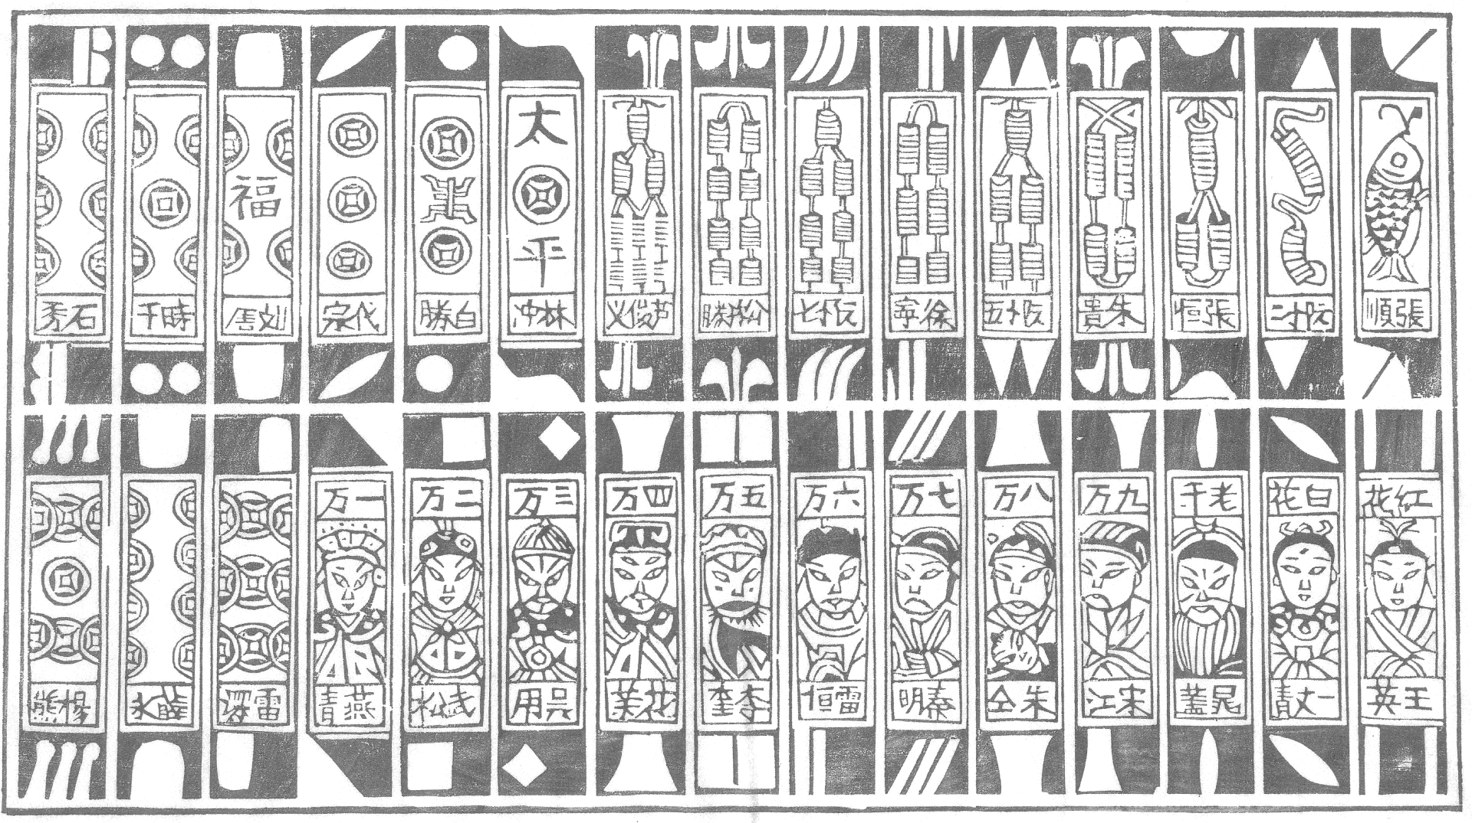

Slide 26
Example: playing cards
As cards migrated to Europe, only the suit of coins remained in Spanish decks:
>>> suits.pop() # Removes and returns the final element ’myriad’
>>> suits.remove(’string’) # Removes the first element that equals the argument

Slide 27
Example: playing cards
Three more suits were added:
>>> suits.append(’cup’) # Add an element to the end
>>> suits.extend([’sword’, ’club’]) # Add all elements of a list to the end

Slide 28
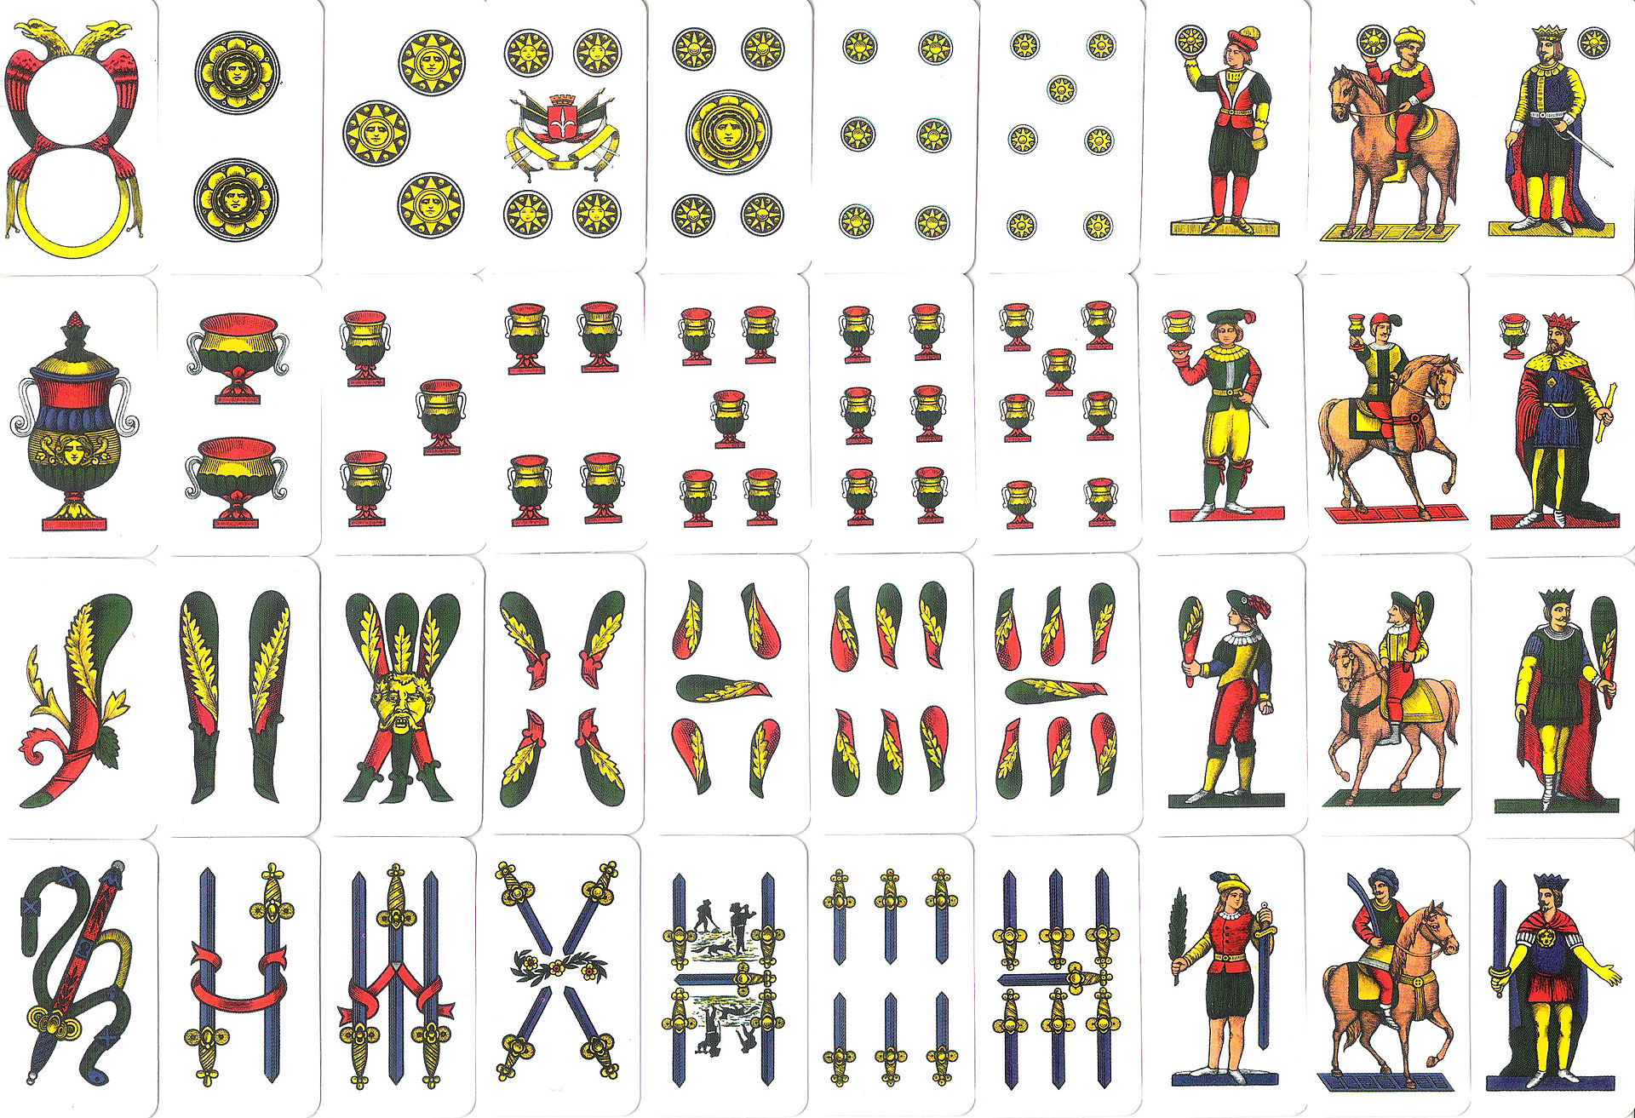
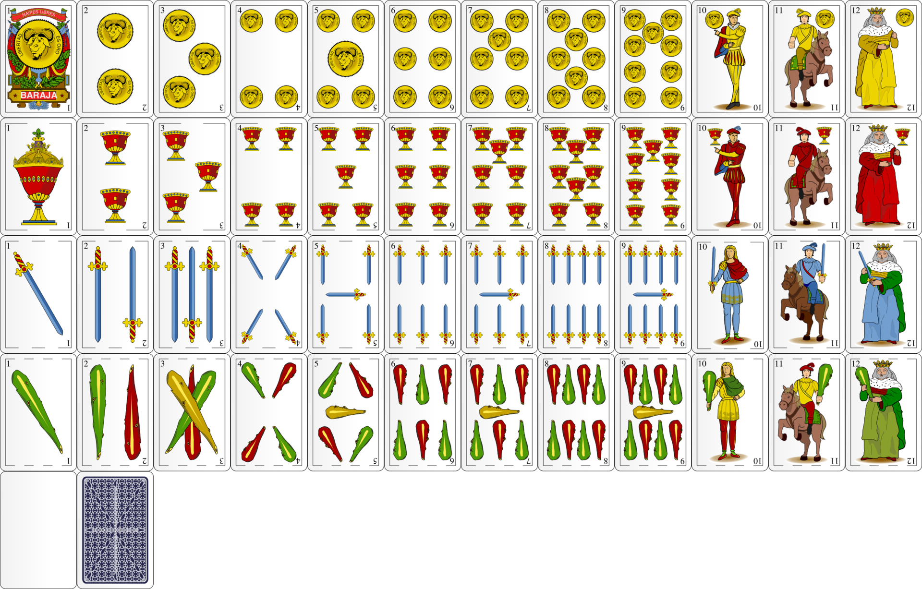

Slide 29
Example: playing cards
Italians called swords spades:
>>> suits[2] = ’spade’ # Replace an element giving the suits of a traditional Italian deck of cards.
>>> suits
[’coin’, ’cup’, ’spade’, ’club’]

Slide 30
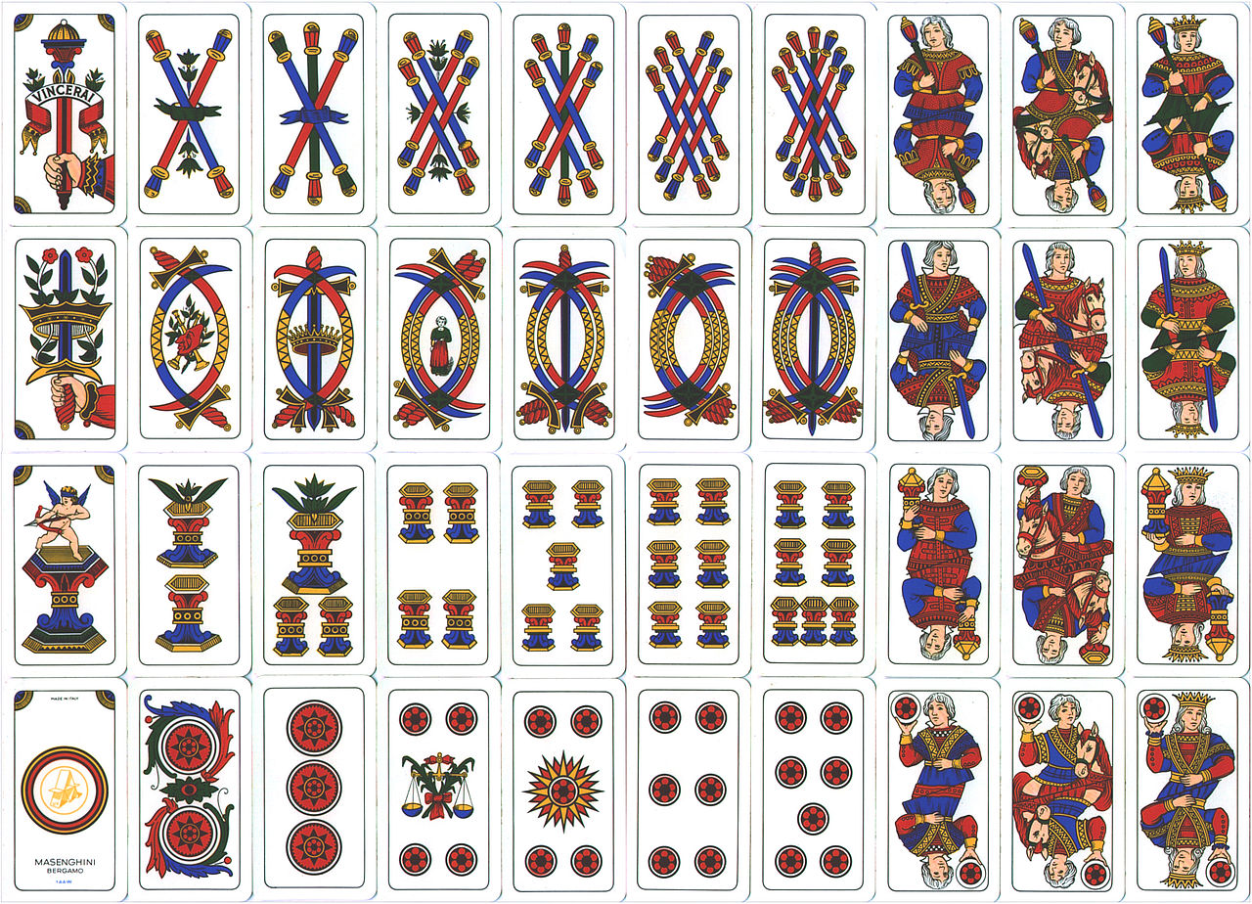

Slide 31


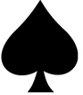

Example: playing cards
The French variant that we use today changes the first two:
>>> suits[0:2] = [’heart’, ’diamond’] # Replace a slice
>>> suits
[’heart’, ’diamond’, ’spade’, ’club’]

Slide 32
Example: playing cards
Methods also exist for inserting, sorting, and reversing lists.
All of these mutation operations change the value of the list; they do not create new list objects.

Slide 33
Sharing and Identity
The object bound to the name chinese_suits has also changed, because it is the same list object that was bound to suits:
>>> chinese_suits # This name co-refers with "suits" to the same list
[’heart’, ’diamond’, ’spade’, ’club’]

Slide 34
Sharing and Identity
Lists can be copied using the list constructor function. Changes to one list do not affect another, unless they share structure.
>>> nest = list(suits) # Bind "nest" to a second list with the same elements
>>> nest[0] = suits # Create a nested list

Slide 35
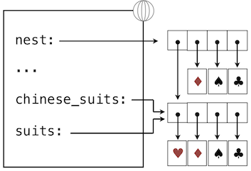
Environment Model

Slide 36
Sharing and Identity
Changing suits will affect only the nested list that is the first element of nest
>>> suits.insert(2, ’Joker’) # Insert an element at index 2, shifting the rest
>>> nest
[[’heart’, ’diamond’, ’Joker’, ’spade’, ’club’], ’diamond’, ’spade’, ’club’]

Slide 37
Sharing and Identity
Undoing this change in the first element of nest will change suits as well
>>> nest[0].pop(2)
’Joker’
>>> suits
[’heart’, ’diamond’, ’spade’, ’club’]

Slide 38
Sharing and Identity
is and is not – comparison operators to test whether two expressions evaluate to the identical object
Two objects are identical if
they are equal in their current value, and
any change to one will always be reflected in the other.
Identity is a stronger condition than equality

Slide 39
Sharing and Identity
>>> suits is nest[0]
True
>>> suits is [’heart’, ’diamond’, ’spade’, ’club’]
False
>>> suits == [’heart’, ’diamond’, ’spade’, ’club’]
True

Slide 40
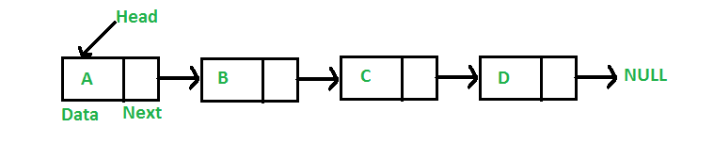
Implementation
A list is a function (dispatch) that has
Content (local state): a recursive list (implemented by us in the class)
Behavior (methods): It checks the input “message” against known messages and takes an appropriate action for each different input

Slide 41

Implementation
Behavior. Responds to 5 different messages:
The first two implement the behaviors of the sequence abstraction
The next two add or remove the first element of the list.
The final message returns a string representation of the whole list contents
???

Slide 42
>>> def make_mutable_rlist():
"""Return a functional implementation of a mutable recursive list."""
contents = empty_rlist
def dispatch(message, value=None):
nonlocal contents
if message == ’len’:
return len_rlist(contents)
elif message == ’getitem’:
return getitem_rlist(contents, value)
elif message == ’push_first’:
contents = make_rlist(value, contents)
elif message == ’pop_first’:
f = first(contents)
contents = rest(contents)
return f
elif message == ’str’:
return str(contents)
return dispatch
Sequence
abstraction
add, remove
String
representation
What’s wrong with this part??
YES, it’s a violation to the Data Abstraction!!
Fix it!

Slide 43
More…
Construct a functionally implemented recursive list from any built-in sequence:
>>> def to_mutable_rlist(source):
"""Return a functional list with the same contents as source."""
s = make_mutable_rlist()
for element in reversed(source):
s(’push_first’, element)
return s
returns an iterable value
Next abstraction level

Slide 44
Construct a functionally implemented lists
Note that the list itself is a function:
>>> s = to_mutable_rlist(suits)
>>> type(s)
<class ’function’>
>>> s(’str’)
"(’heart’, (’diamond’, (’spade’, (’club’, None))))"
Fix it to:
[‘heart’, ‘diamond’, ‘spade’, ‘club’]
Why does it look like a nested tuple?

Slide 45
Manipulate it
We can pass messages to the list s that change its contents, for instance removing the first element:
>>> s(’pop_first’)
’heart’
>>> s(’str’)
"(’diamond’, (’spade’, (’club’, None)))"
Fix it to:
[‘diamond’, ‘spade’, ‘club’]
What is the list’s representation?

Slide 46
Message Passing
How to implement mutation operations of Python lists, such as extend and insert?
as functions, which use the existing messages pop_first and push_first to make all changes
add additional elif clauses to the body of dispatch, checking for a message and applying the appropriate change to contents directly

Slide 47
Message Passing
Approach, which encapsulates the logic for all operations on a data value within one function that responds to different messages
Python dictionaries provide a data type that will help us manage the mapping between messages and operations

Slide 48
Dictionaries
A dictionary contains key-value pairs, where both the keys and values are objects
The purpose – to provide an abstraction for storing and retrieving values that are indexed not by consecutive integers, but by descriptive keys

Slide 49
Dictionaries
The values of various Roman numerals:
>>> numerals = {’I’: 1.0, ’V’: 5, ’X’: 10}
Looking up values by their keys:
>>> numerals[’X’]
10

Slide 50
Dictionaries
Can have at most one value for each key
Adding new key-value pairs and changing the existing value for a key = assignment statement:
>>> numerals[’I’] = 1
>>> numerals[’L’] = 50
>>> numerals
{’I’: 1, ’X’: 10, ’L’: 50, ’V’: 5}

Slide 51
Dictionaries
The methods keys, values, and items all return iterable values
>>> sum(numerals.values())
66

Slide 52
Dictionaries
A list of key-value pairs can be converted into a dictionary by calling the dict constructor function
>>> dict([(3, 9), (4, 16), (5, 25)])
{3: 9, 4: 16, 5: 25}

Slide 53
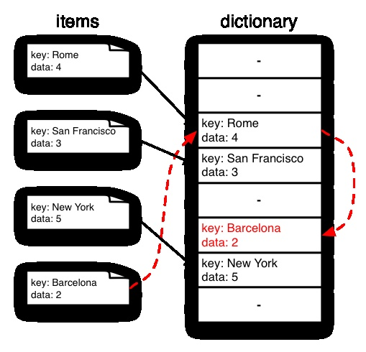
Dictionaries do have some restrictions
A key of a dictionary cannot be an object of a mutable built-in type (unhashable type)

Slide 54
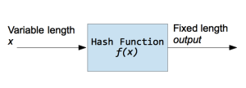
Intro to a hash function
A hash function is a function that takes input of a variable length sequence of bytes and converts it to a fixed length sequence.
It is a one-way function – calculating f(x) is fast and simple, but not vice versa.
Most of the time a hash function will produce unique output for a given input. However, it depends on the algorithm.

Slide 55
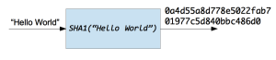
Intro to a hash function
The hash code for the string "Hello Word" with the SHA1 function is 0a4d55a8d778e5022fab701977c5d840bbc486d0
Hash functions are used inside some cryptographic algorithms, hash tables, password storage and more.
A Python programmer may need these functions to check for duplicate data or files, to check data integrity of transmitted information over a network, to securely store passwords in databases, or else.

Slide 56
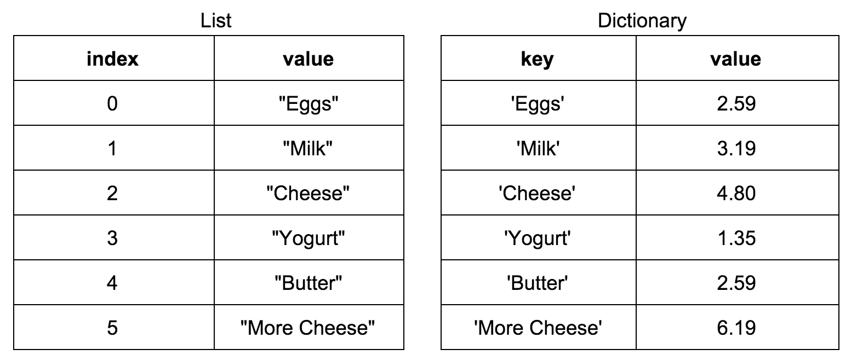
Dictionaries, restrictions, cont.
There can be at most one value for a given key
Each key is unique

Slide 57
Dictionaries
Method get returns either the value for a key, if the key is present, or a default value
Arguments: the key and the default value
>>> numerals.get(’A’, 0)
0
>>> numerals.get(’V’, 0)
5

Slide 58
Dictionaries
Dictionaries also have a comprehension syntax
Evaluating a dictionary comprehension yields a new dictionary object:
>>> {x: x*x for x in range(3,6)}
{3: 9, 4: 16, 5: 25}
Notes:
>>> n= (1,2,3)
>>> [x*2 for x in n]
[2,4,6]

Slide 59
Implementation
We can implement an abstract data type that conforms to the dictionary abstraction as a list of records, each of which is a two-element list consisting of a key and the associated value

Slide 60
>>> def make_dict():
"""Return a functional implementation of a dictionary."""
records = []
def getitem(key):
for k, v in records:
if k == key:
return v
def setitem(key, value):
for item in records:
if item[0] == key:
item[1] = value
return
records.append([key, value])
def dispatch(message, key=None, value=None):
if message == ’getitem’:
return getitem(key)
elif message == ’setitem’:
setitem(key, value)
elif message == ’keys’:
return tuple(k for k, _ in records)
elif message == ’values’:
return tuple(v for _, v in records)
return dispatch
for k, v in records
if k == key:
v = value
?
האם זה רצף? למה?
בבית ....

Slide 61
Manipulating dictionary
>>> d = make_dict()
>>> d(’setitem’, 3, 9)
>>> d(’setitem’, 4, 16)
>>> d(’getitem’, 3)
9
>>> d(’getitem’, 4)
16
>>> d(’keys’)
(3, 4)
>>> d(’values’)
(9, 16)
כיצד להיפטר מארגומנטים מיותרים ב-dispatch ?

Slide 62
Manipulating dictionary
>>> d = make_dict() >>> d = make_dict()
>>> d(’setitem’, 3, 9) >>> d(’setitem’)(3, 9)
>>> d(’setitem’, 4, 16) >>> d(’setitem’)(4, 16)
>>> d(’getitem’, 3) >>> d(’getitem’)(3)
9
>>> d(’getitem’, 4) >>> d(’getitem’)(4)
16
>>> d(’keys’) >>> d(’keys’) … ?
(3, 4)
>>> d(’values’)
(9, 16)
כיצד להיפטר מארגומנטים מיותרים ב-dispatch ?

Slide 63
Usage Nonlocal statement implementation
def make_account(balance):
"""Return a withdraw function that draws down
balance with each call."""
bal = {'balance':balance}
def withdraw(amount):
if amount > bal['balance']:
return 'Insufficient funds'
bal['balance'] = bal['balance'] - amount
return bal['balance']
return withdraw

Slide 64
Dispatch dictionary instead of dispatch func
>>> def make_mutable_rlist():
"""Return a functional implementation of a mutable recursive list."""
contents = empty_rlist
def length():
return len_rlist(contents)
def get_item(ind):
return getitem_rlist(contents, ind)
def push_first(value):
nonlocal contents
contents = make_rlist(value, contents)
def pop_first():
nonlocal contents
f = first(contents)
contents = rest(contents)
return f
def str():
return str(contents)
return {‘length’:length, ‘get_item’:get_item, ‘push_first’:push_first,
‘pop_first’: pop_first, ‘str’:str}

Slide 65
Manipulating
Dispatch function
>>> m = make_mutable_rlist()
>>> m('str‘)
'None'
>>> m('push_first‘, 5)
>>> m('push_first‘, 3)
>>> m('str‘)
'(3, (5, None))' function
Dispatch dictionary
>>> m = make_mutable_rlist()
>>> m['str']()
'None'
>>> m['push_first'](5)
>>> m['push_first'](3)
>>> m['str']()
'(3, (5, None))'

